Slide 1

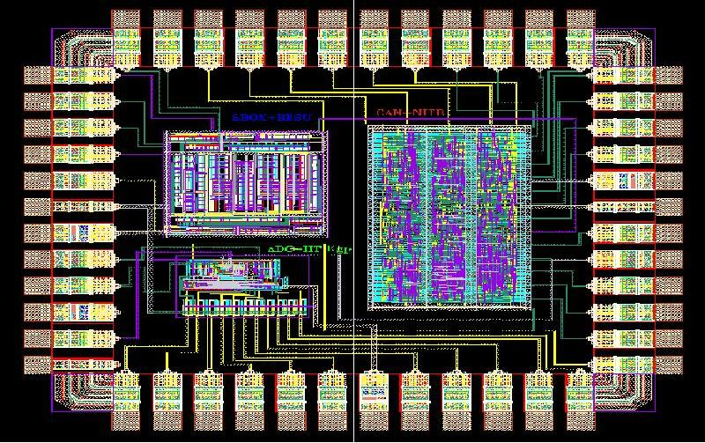
SEMICONDUCTOR INTEGRATED CIRCUIT LAYOUT DESIGN ACT (SICLD) 2000
UNIT-II

Slide 2
Introduction
The semiconductor chip protection Act of 1984, is an act of the US congress that makes the layouts of integrated circuits legally protected upon registration and hence illegal to copy without permission. In India, the Act for protection of the layout designs of integrated circuits in India, came into force on 4th September, 2000 and is called the SICLD (semiconductor integrated circuit layout design) Act, 2000.
This was passed in accord with the TRIPS agreement where member states had pledged to give protection to the layout design of silicon chips, an integral part of computers and advanced electronic devices.

Slide 4
Meaning of Semiconductor chip
An integrated circuit or monolithic integrated circuit (also referred to as an IC, a chip, or a microchip) is a set of electronic circuits on one small plate ("chip") of semiconductor material, normally silicon.

Slide 5

▶ A product having transistors
▶Circuitry elements inseparably formed on a semiconductor material
▶ Insulating material inside the semiconductor material
▶ Designed to perform an electronic circuitry function.

Slide 6
Definition
The act defines a 'semiconductor integrated circuit' as, "a product having transistors and other circuitry elements which are inseparably formed on a semiconductor material or on insulating material or inside the semiconductor material and designed to perform an electronic circuitry function".

Slide 7
SICLD
Vision
Promotion of Semiconductor Integrated Circuits Layout-Design in the country.
Mission
Act as a catalyst for protection of Intellectual Property of Semiconductor Integrated Circuit i.e. Layout-Designs.
Objectives
Protecting of Intellectual Property of Semiconductor Integrated Circuits and matters connected therewith and incidental there to Create awareness for protection of Intellectual Property of Semiconductor Integrated Circuits Layout-Designs.

Slide 8
Top countries for producing semiconductor chip are:
1. Taiwan
South Korea
Japan (102 fabrication plants)
The United States and (76 fabrication plants)
Chaina (70 fabrication plants)
Germany (20 fabrication plants)
Israel (4 fabrication plants)
Netherlands

Slide 9
Feature of the Act
• Sec 3 of the act confers power on the central government to appoint a Registrar of SICLD and other officers required to assist him in his work.
• Sec 5 makes provisions for the creation of a SICLDL registry.
• Sec 6 makes provisions for maintaining a record of SICLDL.
• According to the section 7 of the act, Registration of a circuit design in India can be done at New Delhi by making an application to registrar of SICLDL.
• The term is 10 years from date of filling or known date of commercialization, whichever is earlier.
•It comes under Ministry of communication and information technology

Slide 10

▶ Any person claiming to be the creator of a layout-design
▶ who is desirous of registering it
▶ shall apply in writing to the Registrar
▶ In the prescribed manner for the registration of the layout- design

Slide 11
key points about the SICLD Act:
Protection of layout designs
Registration requirements
Enforcement mechanisms

Slide 12
Recent developments in India’s Semiconductor
India Semiconductor: Launched in 2022, its aim(global semiconductor manufacturing hub)
Focus on IP protection

Slide 13
Registration
Registration of circuit design in India can be done in India by making an application to registrar of SICLDL, New Delhi.
Web link- http://sicldr.gov.in

Slide 14

▶ Application to be filed
▶ If Not opposed
▶ And time for notice of opposition expired
▶ If opposed and decided in favour of the applicant
▶ The Registrar shall register the said layout-design

Slide 15
Registration process
The date of making the application be deemed to be the date of registration
▶ On the registration of a layout-design, Certificate issued by the registrar
▶ If registration of a layout-design is not completed within twelve months, application considered as abandoned
▶ Unless it is completed within the time specified, in the notice issued by the registrar

Slide 16

▶ 10 years, counted from the date of filing Or from the date of first commercial exploitation any where in India or in any country whichever is earlier.

Slide 17
Designs not registerable:
According to the Section 7 the following layout designs are not registerable:
Not original
Already commercially exploited
Not distinctive
Not capable of being distinguishable from any other registered layout design.

Slide 18

Exclusive rights to use the layout-design
▶ To obtain relief
▶ The rights conferred by the registration, irrespective of the fact as to whether the layout-design is incorporated in an article or not

Slide 19

▶ Any act of
▶ Reproducing
▶ Importing
▶ Selling
▶ Or distributing for commercial purposes amounts to Infringement

Slide 20
Exceptions
Where such act is performed for:
▶ limited purposes of scientific evaluation
▶ Analysis
▶ Research
▶ Teaching
▶ or where a person, on the basis of scientific evaluation or analysis of a registered layout-design, creates another layout-design which is original, same does not amount to infringement

Slide 21
Infringement penalties
According to the Section 56, infringing a registered layout design knowingly and wilfully makes a person liable for imprisonment upto 3 years or fine of a minimum of 50,000/- rupees and a maximum of 10 lakh rupees or both.
According to the Section 57, any person making a false representation about a layout design and claiming it to be a registered layout design, when it is not so, is liable for an imprisonment of upto 6 months or a fine of upto 50,000/-.

Slide 22
Benefits:
Protection for effort and investments in design and improvement of circuits.
Recognition of original effort.

Slide 23
THANK YOU

